Slide 1
Double Vision in Travel Essays: Something Old and Something New
By John Bennion
John_Bennion@byu.edu
*Remember to record any questions you have using Chat.

Slide 2
Subjects of travel writing:
Tourism (personal and family trips)
Outdoor experiences (backpacking, climbing, hiking, skiing, rafting, canoeing, etc.)
Study abroad or other educational travel

Slide 3
Genres of travel writing:
How to (Rick Steves)
Journalistic
Personal or meditative essay (the kind found in Best American Travel Essays)
Blend

Slide 4
Three kinds of Double Vision
Reinterpreting a single experience (Then I thought x, now I think y.)
Combining an experience (material) from the present with experiences (material) from the past.
Combining personal experiences and researched material

Slide 5
Recording details
Carry a notebook or journal with you wherever you travel. It can be small enough to fit in your pocket or large enough to sketch in.
“Shipping Out: On the (nearly lethal) comforts of a luxury cruise”
by David Foster Wallace.
Harpers Magazine, January 1996

Slide 6
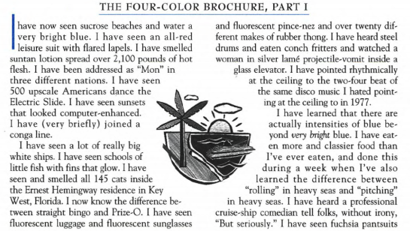

Slide 7
From “Climbing Shingle Peak” by Joey Franklin

Slide 8
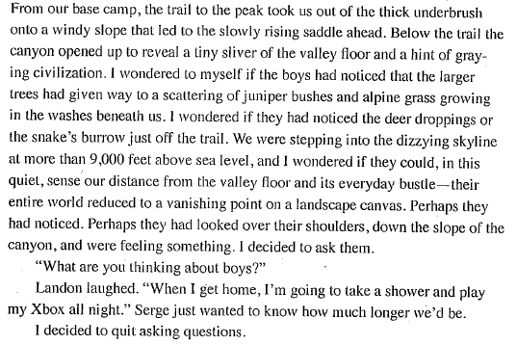

Slide 9
Practice/Discussion (stop the presentation)
Practice: Record a sentence about each of three trips that you could write essays about, one you have already taken, and two that you plan to take.
Discuss: Who has an unusual future trip planned? Put your sentence in Chat.
Practice: In 3 minutes, describe the back of your own hand, listing at least 10 distinct characteristics or descriptors. The idea is that if someone had your description, they could identify your hand.
Discuss: What did you learn from this exercise about your ability to describe well? Do you carry a journal with you everywhere?

Slide 10
Discovering/creating the meaning of an experience
Allow meaning to grow out of the experience as you write about it. Meaning is often better revealed as a question or tension to explore than as a didactic statement of meaning—a conclusion. Predetermined meaning generally feels both false and didactic; few people will want to read essays written to demonstrate a predetermined meaning.
In the previous example from Joey Franklin’s essay, the essay is partly about his struggle to impose his own meaning on the experience of the boys in his Scout troup.
The following is another paragraph from Joey Franklin’s essay:

Slide 11
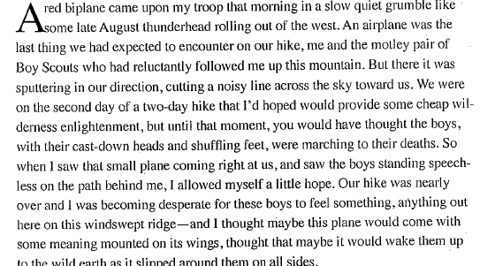

Slide 12
From “Like the Lilies”:
Up to my thighs in a brook in the Yorkshire Dales, I was lost again—my shoes and the legs of my hiking shorts soaked. “There’s no path over here either,” I said, an astute observation, because I had just climbed a barbed-wire fence and forced myself through waist-high stinging nettle to get to the brook. The students looked at me as if I were crazy. I didn’t have a clue where we turned off the Pennine Way, and I was frantic inside, though it manifested itself in a forced and manic grin.
The worst part of getting lost when you’re supposed to be the guide is that it’s undignified. When I lost my way, which was every time I got behind the wheel of our luggage van and often when we set out on foot cross-country, the students laughed. It was always a sweet, you’re-one-of-us kind of laughter, as if my failings endeared me to them.

Slide 13
That Time Writer Michael Chabon Packed His Family Into a Minivan With a Stranger in Morocco
Bon Appétit, APRIL 23, 2015
We were heading down to Fes from blue Chefchaouen and making decent time when our driver left the autoroute for a stretch of doubtful road. A modest sign pointed, in French and Arabic, to some unknown town.

Slide 14
I have eaten good food in unprepossessing locales, but I doubt the disparity between the crude, shabby atmosphere of that nameless cement-block dispensary of protein and redemption and the quality of the lunch laid on by the butcher of Zegota will ever be matched. When it arrived, the kefta was easily the best we ate during our two weeks in Morocco—and we ate a lot of kefta. The tagine arrived sizzling in its Munchkin-hat clay oven, the long green peppers delivering a welcome and overdue burn. The ubiquitous mint tea was neither oversweetened nor bitter. The day was bright and cool, and after the meal we lingered a moment on that gritty concrete terrace, six Jews sitting in the sunshine between a mosque and a shambles, grooving on the mingled aftertastes of sugar and mint and barbecue and chiles, as happy, collectively, as we had been in Morocco or might ever be again in our lives.

Slide 15
Practice/Discussion (stop the presentation)
Discussion: What questions do you have about exploring the meaning of your travel experience?
Practice: Write a paragraph (4-5 sentences) describing why the trip you listed (the past trip) is important to you. What questions or tensions about yourself, the place you traveled to, or general human culture might be significant to explore in writing?

Slide 16
Split perspective
From “Lilies of the Field”:
I am the child of an alcoholic. When I was a teenager in a tight and repressive Mormon village, it felt like being abandoned in a private desert. I could control nothing, do nothing to keep me and my family from disappearing from before God’s throne. My kind, taciturn father self-medicated his depression with cooking sherry. Because drinking any alcohol was against the Mormon commandments, I thought his sin was as evil as adultery. I was ashamed of him. Now that I’m more enlightened, I’m ashamed of being ashamed of him. This is what my therapist calls progress.

Slide 17
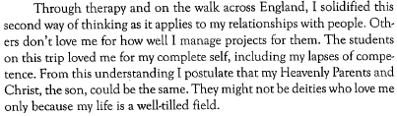

Slide 18
Why We Play:
Doing What We Love, Despite the Risks by Eva Holland
SB Nation, June 25, 2014
Rugby had, for a time, given me everything. But around the same time I'd begun to outgrow my need for it, I'd also begun to understand its potential cost. I racked up pulled muscles and strained ligaments and chipped a bone in my ankle that still aches under pressure, more than 15 years later.

Slide 19
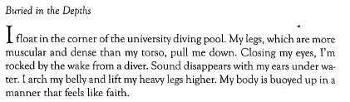
Combining past and present experiences in a weaved essay,
From “Like the Lilies” (recent experience):

Slide 20
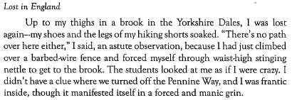
Experience from a few years before

Slide 21
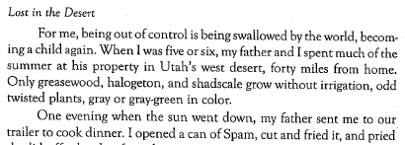
Experience from when I was a child

Slide 22
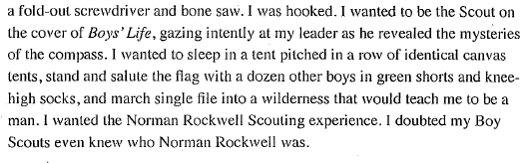
From “Climbing Shingle Peak” by Joey Franklin

Slide 23
Practice/Discussion (stop the presentation)
What questions do you have about split perspective (showing a former perspective and a new one)? What questions do you have about creating a weave of old and new experiences?
Write two paragraphs about a place you have visited more than once—a place that you have changed your view of. One paragraph should show your former perspective and the second should show a newer perspective.

Slide 24
Creating a weaved essay with your perspective and another’s perspective.
In the next example is from ”Climbing Shingle Peak” by Joey Franklin. He alternates paragraphs about his own experience with the Boy Scout troop with paragraphs about Henry David Thoreau. The essays explorations are enhanced by moving back and forth between these two.

Slide 25
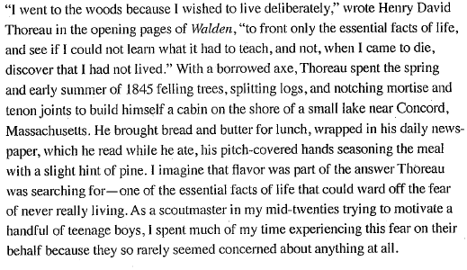

Slide 26
Liz Knight “Rivers”
Now is the time of year, when the days are shorter and the nights longer, that I lie in bed and think about rivers. There is a bigger window of time in which I feel justified in being in bed and my skin fades to a mottled white. There is snow on the ground and – today, at least – snow blowing through the streets. It’s cold. I love this time of year. But the rivers are still flowing, and this haunts me a little as I lie in bed at night.
The spell of the canyon is awfully strong
and it holds something of me I know it will never give up.
Haldane “Buzz” Holmstrom, 1938

Slide 27
Rivers must have haunted Haldane “Buzz” Holmstrom, as well. Holmstrom was a service station attendant in the tiny logging town of Coquille, Oregon, who in the 1930s inexplicably developed an interest in running rivers. He designed and built his own boats, with varying success, and began piloting them down the rivers closest to his home: the Rogue, the Coquille, the Chetco, the Umpqua, and the Smith—a new boat for each new river. With no prior river-running experience and no one to instruct him, he was forced to learn quickly how to row and read the currents.

Slide 28
Researching culture and talking to/interviewing locals
We can enhance the texture of our essays by doing computer/library research on subjects connected to the story of our experience and by interviewing people we meet on our journey (including those who travel with us).
Taking notes: A great essayist, Brian Doyle, said once that when he’s talking to people, he gives them full attention; then afterward, in private, he immediately writes in his notebook everything he remembers. Making a recording can help, but it may distract the person you’re talking to.
Privacy: Make sure you think carefully about using sensitive information. You might get permission of the interviewee, keep their identity secret, or take the risk of offending them.

Slide 29
From Eva Holland’s essay:
In 2006, researchers in the U.K. published a survey of 24 peer-reviewed studies examining people's motivations for playing sports. Echoing the Nike ad, the survey found that teenage girls increased their self-esteem and tapped into new social support networks when they joined a sports team. But those rewards came with a corresponding sacrifice. "While many girls wanted to be physically active," the researchers wrote, "a tension existed between wishing to appear feminine and attractive and the sweaty muscular image attached to active women ... A clear opposition can be seen between girls wanting to be physically active and at the same time feminine."

Slide 30
Heart of Dark Chocolate by Rowan Jacobsen
Outside magazine, Sep 13, 2010
WILD CACAO? A MYTH, disappeared ages ago, extinct—that's what my industry sources had said, anyway. Chocolate is made by fermenting, drying, roasting, and grinding the almond-size fruit seeds of Theobroma cacao, which has been farmed—and therefore much changed by humans—for thousands of years. The ancestors of the Maya perfected the process in Mesoamerica, and it was later passed on to the Aztecs. In the 16th century, conquistador chronicles tell us, the Maya were cultivating vast cacao orchards throughout the Yucatán and Chiapas. It was thoroughly domesticated. Until recent genetic testing proved that the tree is actually native to Amazonia, many scholars believed it hailed from the Maya homelands.

Slide 31
How to Use a Squat Toilet
By Frank Bures
World Hum: The Best Travel Stories on the Internet, 25 Sept. 2006
Beginning Squatting: I called Doug Lansky, a traveler and travel writer who knows the hardships of squatting. “It’s difficult,” said Lansky, who edited a book called, There’s No Toilet Paper on the Road Less Traveled.
“There aren’t any helpful directions, like a seatback pocket, that show you how to use a squat toilet. You have to sort of find your own technique, whether you’re up more on the balls of your feet, or whether you get a little more comfortable and put your heels down. And if you get advanced, you can even bring the newspaper in with you. That’s sort of the double black diamond mogul run of squatting.”

Slide 32
World Hum travel advice guru and Vagabonding author Rolf Potts has also seen a few squatters in his day. “In places like India, and many parts of Asia,” he told me, “a bathroom won’t have toilet paper. It will have a little cup of water. Basically, after you’ve done your business, you take your left hand and wash the exit hole of fecal matter, then wash your hand. That’s why nobody shakes hands with their left hand in most of Asia and the Middle East, because that’s your wiping hand.”
Dr. Jane Wilson-Howarth is probably the world’s foremost expert on excretion, a real Buddha of Bowel Movements, and she’s not afraid to get into the details.

Slide 33
From Michael Chabon’s essay:
“Before, they grow the hashish here,” he said. “Very good hashish. The best.”
I saw that he expected this American whom fate had placed in the front seat of his employer’s second-best minivan, dressed in a knitted wool taqiyah, or skullcap, and a hooded djellaba over an Illmatic T-shirt, to take an interest in the subject of hashish.
“Interesting,” I said, trying to sound uninterested.
“Yes, but it is finished. The government says it will be better to grow the tobacco.”
From a public health perspective, the underlying premise of this policy struck me as grievously flawed, but there was nothing much Rida or I could do about it. So I let it pass.

Slide 34
Practice/Discussion (stop the presentation)
Practice: If you were to make your essay about the trip you took into a conversation, what writer or other person would you converse with? Write a few details about that person that you might use.
What questions do you have about research and interviewing?

Slide 35
Finding places to publish
The basic rule is read the journal where you want to publish, so you know the journal’s interests and style.
My piece ”Like the Lilies” was published in Dialogue: A Journal of Mormon Thought.
Joey Franklin’s “Climbing Shingle Peak” was published in Sport Literate.
Others I’ve quoted were published in Harpers Magazine, Outside, Bon Appétit, SBNation, and World Hum: The Best Travel Stories on the Internet.

Slide 36
Other sources:
Best American Essays contains a list in the back of where the pieces were originally published.
Newspapers occasionally publish travel essays, but they will be heavy on information and light on reflection/meditation.
Use the internet to find other travel journals where personal essays are accepted.

Slide 37
Practice/Discussion (stop the presentation)
What unanswered questions do you still have about the process of writing travel essays?

