Slide 1
PROBLEM:
YOU NEED TO PERSUADE A MAJOR MUSICAL ARTIST
TO COME PERFORM IN YOUR SMALL TOWN.
THEY HAVE NO NATURAL INCENTIVE TO DO SO.
WHAT CAN YOU DO?
Can the s.u.c.c.e.s.S. KEYS HELP?

Slide 2
ONE MAN’S GOAL:
GET THE FOO FIGHTERS TO DO A CONCERT IN CESENA, ITALY—A TOWN ABOUT 2/3 THE SIZE OF PROVO, UTAH.
HE HAD AN IDEA.

Slide 4
Let’s create a “s.u.c.c.e.s.s score”:
https://docs.google.com/document/d/1J-gO7mUoErlbK6zent2SvICXBUpSadc1soWCQy2RvbM/edit

Slide 5
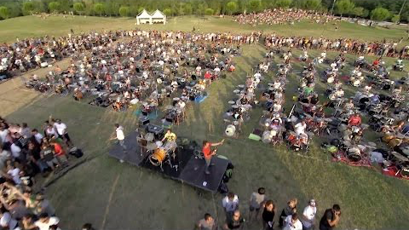

Slide 6
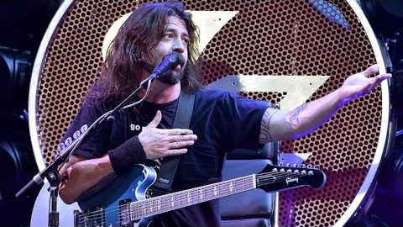
DID IT WORK?

Slide 7
LET’S BREAK THIS INTO S.U.C.C.E.S.S KEYS:
WAS HIS IDEA SIMPLE? (AS DISTINCT FROM “EASY”?)
WAS IT UNEXPECTED?
WAS IT CONCRETE?
WAS IT CREDIBLE?
DID IT USE EMOTION EFFECTIVELY?
IS THERE A STORY HERE?

Slide 8
REMEMBER THE S.U.C.C.E.S.S KEYS!
WE WILL TALK ABOUT THEM AS WE DEVELOP ALL FUTURE WRITING ASSIGNMENTS!

